Slide 1




Parallelizing CNN and Transformer Encoders for Audio Based Emotion Recognition in English Language
Adam Satria Adidarma
Notes:
A python framework that helps automate ranking the performance of complex solution space in big data framework analytics.

Slide 2
01.
Introduction
Notes:
Before moving further, let’s talk about the background and real life problem for papaya

Slide 3






Introduction
Speech emotion recognition (SER) is the task of recognizing the emotional aspects of speech independently over the semantic content and is one of the emerging applications in the context of Artificial Intelligence (AI). SER is an important task in human-computer interaction, which can be used for various applications such as personalized advertising, mental health monitoring, and speech therapy.
This study explored a parallelized approach to emotion recognition using Convolutional Neural Networks (CNN) and Transformer encoders for audio-based emotion recognition in the English language.

Slide 4
Background
Emotion recognition has traditionally been performed using handcrafted features and machine learning algorithms such as SVM. However, these methods are limited by their reliance on domain expertise and lack of generalization.
Recent advances in deep learning-based Convolutional Neural Network (CNN) have shown promising results outperforming traditional handcrafted feature-based methods in image classification.
In the field of NLP, state of the art deep architecture such as GPT-3 and BERT are emerging to solve sequential learning problems based on the self-attention mechanism in the Transformer Network, making them suitable for emotion recognition tasks.

Slide 5
Problem Statement
How to combine the Transformer Encoder and CNN to detect human emotions from audio data?
How to optimize the accuracy of the model architecture?
Which classification methods are more accurate between SVM, LeNet-based CNN, CRNN, and Parallel Transformer Encoder with CNN for audio-based emotion detection?

Slide 6
02.
Parallel Transformer Encoder and CNN Architecture
Notes:
Explaining the system architecture

Slide 7
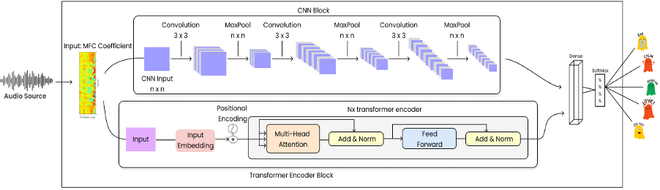
Workflow

Slide 8
Designed Method
A combination of Transformer Encoder block and CNN-based architecture with a series of convolutional and pooling layers. These blocks are combined with a dense layer, and the resulting output is passed to a softmax activation function to convert prediction scores into a probability distribution of target class.
Notes:
A combination of Transformer Encoder consisting of self-attention layers, followed by a feedforward layer that consisted of two linear transformations with a ReLU activation in between and CNN-based architecture with a 3x3 convolution layer followed by an ELU activation function, batch normalization, and pooling layers. These blocks are combined with a dense layer, and the resulting output is passed to a softmax activation function to convert prediction scores into a probability distribution of target class.

Slide 9
Methodology
1.
Pre-Processing
3.
Build Model
2.
Feature Extraction
Transforming raw audio signals into a format that is suitable for machine learning algorithms to extract meaningful information
Construct predictive model using the processed data and extracted features, find appropriate algorithm, training the model on the data, and evaluating its performance.
Extract spectral characteristics of sound by transforming the audio waveform into a compact representation with MFCC.

Slide 10
Datasets
1.
CREMA-D
3.
SAVEE
2.
RAVDESS
Contain diverse collection of acted emotional expressions, including speech and facial expressions, from professional actors
Audio Recordings were recorded in a laboratory environment with high-quality audio-visual equipment, processed and labelled, resulting in a high-quality audio data.
Provide balanced representation of male and female voices, creating comprehensive sample that represents emotional expressions across genders.

Slide 11
Model Evaluation
1.
Train-Validation Curve
3.
Confusion Matrix
2.
Accuracy
Visual representation of model performance during training, showing the progression of the loss and accuracy for both the training and validation sets over epochs or iterations.
Summarizes the performance of a classification model by displaying the counts of true positive, true negative, false positive, and false negative predictions.
Provides overall measure of model performance by measuring the proportion of correctly predicted instances out of the total number of instances.
Notes:
Conf Matrix: provides insights into the model's ability to correctly classify different classes and helps assess its performance in terms of precision, recall, and F1 score.

Slide 12
03.
Results

Slide 13
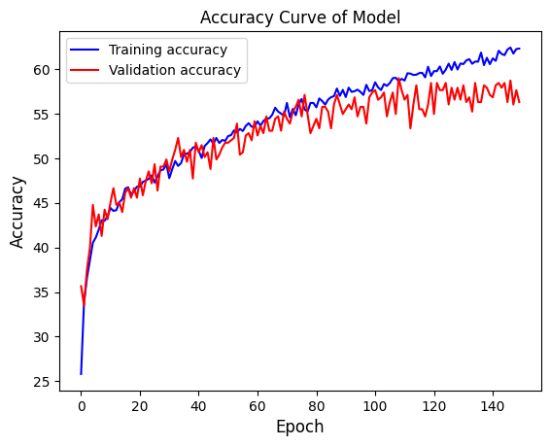
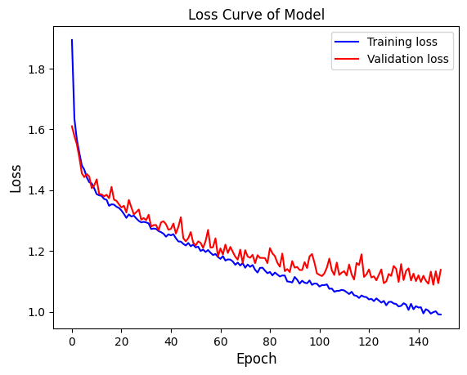
Accuracy & Loss Curve
CREMA-D
Notes:
Accuracy trend: Explain how the accuracy metric reflects the model's ability to correctly classify emotions in the audio data.
Loss trend: Explain that loss is a measure of how well the model is fitting the training data. A decreasing loss indicates that the model is learning and converging towards optimal performance.
Convergence - Overfitting: Discuss the possibility of overfitting or underfitting based on the accuracy and loss curves. Overfitting occurs when the model performs well on the training data but fails to generalize to new data
Fluctuation: If there are plateaus or fluctuations in the accuracy and loss graphs, explain the potential reasons behind them, Fluctuations may suggest that the model is struggling to converge.

Slide 14
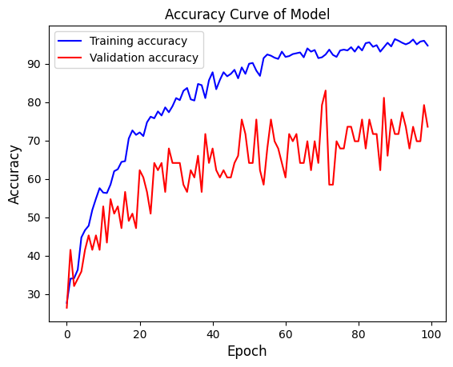
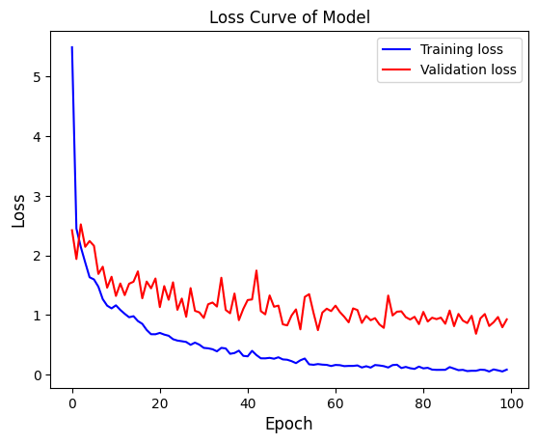
Accuracy & Loss Curve
RAVDESS
Notes:
Accuracy trend: Explain how the accuracy metric reflects the model's ability to correctly classify emotions in the audio data.
Loss trend: Explain that loss is a measure of how well the model is fitting the training data. A decreasing loss indicates that the model is learning and converging towards optimal performance.
Convergence - Overfitting: Discuss the possibility of overfitting or underfitting based on the accuracy and loss curves. Overfitting occurs when the model performs well on the training data but fails to generalize to new data
Fluctuation: If there are plateaus or fluctuations in the accuracy and loss graphs, explain the potential reasons behind them, Fluctuations may suggest that the model is struggling to converge.

Slide 15
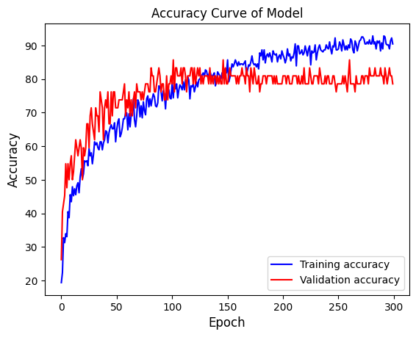
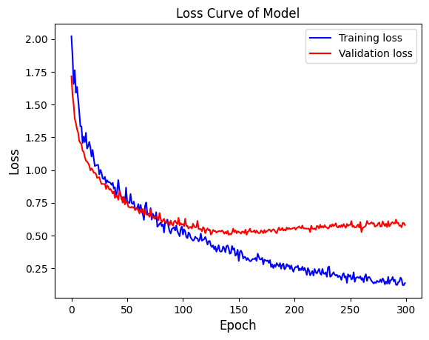
Accuracy & Loss Curve
SAVEE
Notes:
Accuracy trend: Explain how the accuracy metric reflects the model's ability to correctly classify emotions in the audio data.
Loss trend: Explain that loss is a measure of how well the model is fitting the training data. A decreasing loss indicates that the model is learning and converging towards optimal performance.
Convergence - Overfitting: Discuss the possibility of overfitting or underfitting based on the accuracy and loss curves. Overfitting occurs when the model performs well on the training data but fails to generalize to new data
Fluctuation: If there are plateaus or fluctuations in the accuracy and loss graphs, explain the potential reasons behind them, Fluctuations may suggest that the model is struggling to converge.

Slide 16
Confusion Matrix
Emotion Labels
> Angry, Fear, Disgust, Happy, Neutral, and Sad
Datasets
> CREMA-D, RAVDESS, and SAVEE
Performance Metrics
> Additional metrics can be derived from the confusion matrix such as, precision, recall, and F1-score.
Notes:
The data preparator module currently supports four relational schema generations

Slide 17
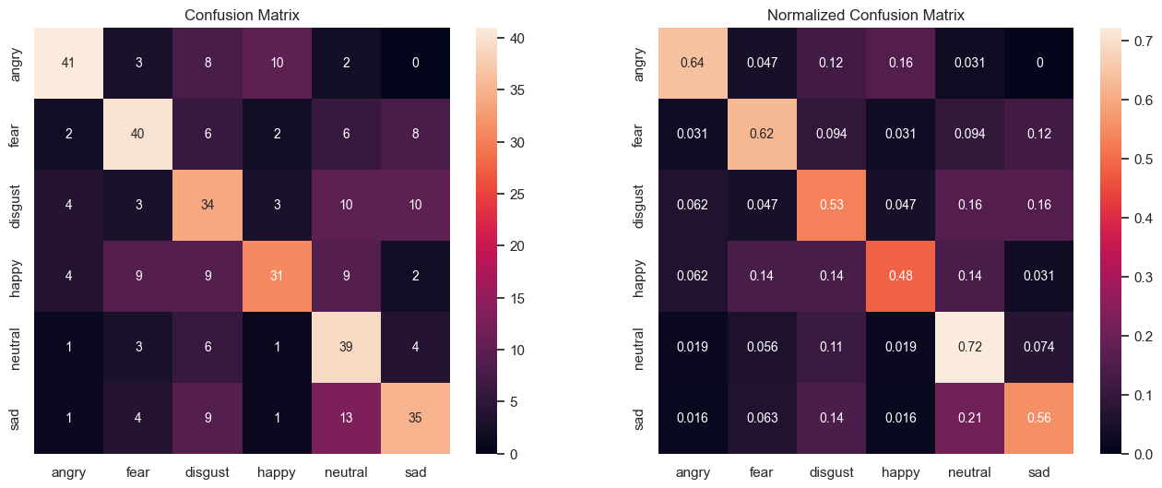
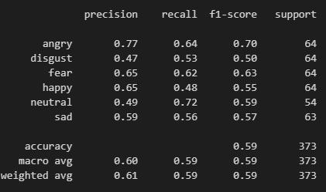
Model Performance
CREMA-D
Notes:
Column is model prediction, row is ground truth
Focus on the off-diagonal elements and discuss the most common types of misclassifications
Discuss the emotions for which the model performs well and those for which it struggles
Discuss on the classification report

Slide 18
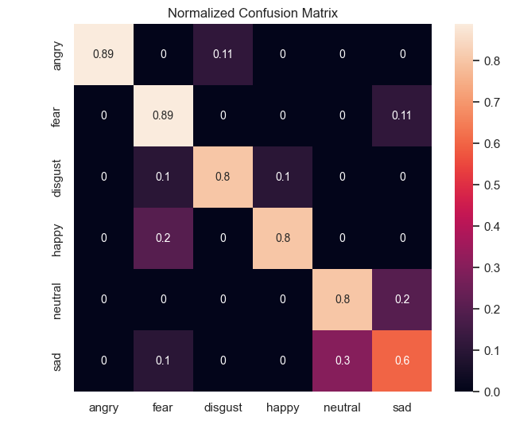
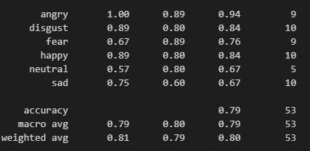
Model Performance
RAVDESS
Notes:
Column is model prediction, row is ground truth
Focus on the off-diagonal elements and discuss the most common types of misclassifications
Discuss the emotions for which the model performs well and those for which it struggles
Discuss on the classification report

Slide 19
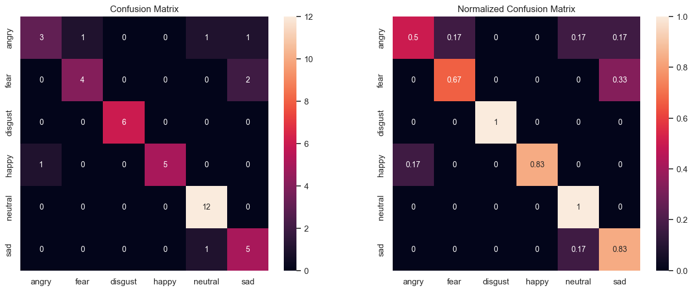
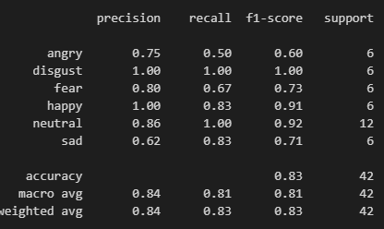
Model Performance
SAVEE
Notes:
Column is model prediction, row is ground truth
Focus on the off-diagonal elements and discuss the most common types of misclassifications
Discuss the emotions for which the model performs well and those for which it struggles
Discuss on the classification report

Slide 20
Model Comparisons
The models being compared include SVM, LeNet CNN, CRNN, and the Parallel Transformer Encoder with CNN Architecture. This section highlight the model with the highest accuracy among all the models compared.

Slide 21
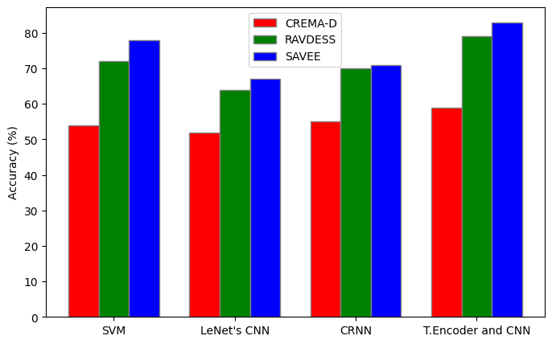
Model Comparisons
Model | Average Accuracy
SVM | 68%
LeNet CNN | 61%
CRNN | 65%
Transformer Encoder and CNN | 74%
Notes:
Discuss relative performance: the differences in accuracy values and their implications
Talk about strength and weakness of the model
Briefly talk about the datasets: Characteristics (audio quality), Bias (lacks diversity), Size, Limitations and Future Considerations

Slide 22
04.
Conclusion

Slide 23
Conclusion
The study addressed the problem of detecting human emotions from audio data by integrating the Transformer Encoder and CNN architectures to capture global dependencies and local patterns in audio features. Optimization techniques include fine-tuning hyperparameters and applying regularization methods, further enhanced accuracy. Comparative analysis on different models revealed that the Parallel Transformer Encoder with CNN Architecture achieved the highest accuracy, followed by the SVM model.
Notes:
The study addressed the problem of detecting human emotions from audio data by integrating the Transformer Encoder and CNN architectures. The Pararel Transformer Encoder with CNN Architecture model demonstrated improved performance in emotion detection by capturing global dependencies and local patterns in audio features. Optimization techniques, including fine-tuning hyperparameters and applying regularization methods, further enhanced accuracy. Comparative analysis with SVM, LeNet-based CNN, and CRNN models revealed that the Parallel Transformer Encoder with CNN Architecture achieved the highest accuracy, followed by the SVM model. The study highlights the effectiveness of the proposed model for emotion detection from audio data.

